Slide 1


Autonomous World Sensors
Artificial Intelligence Training
Created by Andrew Ferlitsch
Instructor Dec, 2017

Slide 2
Introduction
The Autonomous World operates with the following:
Sensors – what we observe in the environment.
Actuators – actions/changes the autonomous entity makes to the environment.
Sensor Fusion – combining multiple sensors to improve
performance/accuracy.
Models – A trained set of rules for operating in the environment.
Policies – A dynamically learned set of rules for adapting how
to operate in the environment.

Slide 3
The Basics
High-Level Decomposition of an Autonomous Vehicle
Fusing of sensor information about the
Environment.
Senses the environment (e.g., camera, audio, LIDAR, GPS, ultrasonic)
Vehicle
Environment
Sensors
Street, Intersection, Parking Lot, etc.
Brains
Fusion
The “brains”,
where sensor
data is interpreted.
Engine
Actuators
The “engine”, where
instructions are sent to
the actuators, and the
Performance is monitored.
Modifies the environment (e.g., drives on road)

Slide 4
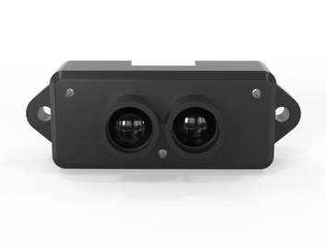
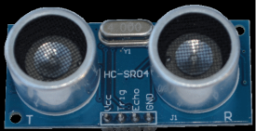
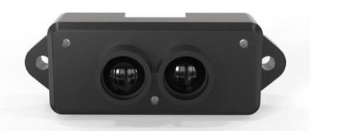
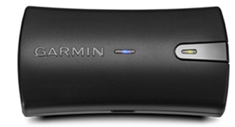
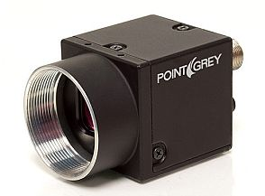
Types of Sensors (1)
Types of Sensors in Autonomous Vehicles
Ultrasonic – Short range distance measurement using sound.
LIDAR – Long range distance measurement using light.
GPS – Location, direction and speed using signals from satellites.
Camera – Object detection and classification

Slide 5
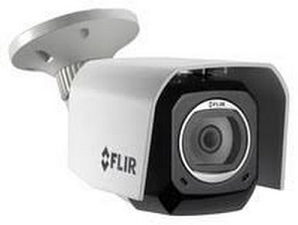
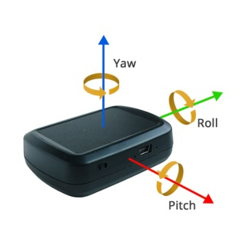
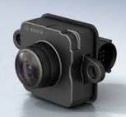
Types of Sensors (2)
Types of Sensors in Autonomous Vehicles
FLIR – Captures infrared light to measure heat.
IMU – Gyroscopes/Accelerometers to measure motion and speed.
Radar – Near range distance detection using high-frequency electromagnetic waves.

Slide 6

Ultrasonic
An Ultrasonic sensor is a device that can measure the distance to an object by using sound waves. It measures distance by sending out a sound wave at a specific frequency and listening for that sound wave to bounce back.
By recording the elapsed time between the sound wave being generated and the sound wave bouncing back, it is possible to calculate the distance between the sonar sensor and the object.
Outbound signal
Sound travels through air at about 344 m/s (1129 ft/s), you can take the time for the sound wave to return and multiply it by 344 meters (or 1129 feet) to find the total round-trip distance of the sound wave.
Elapsed time between
sending and receiving
signal.
Bounce back signal
distance = $\frac{\left(speed of sound\right) x (elapsed time)}{2}$
Divide by two accounts for round-trip (there and back)

Slide 7
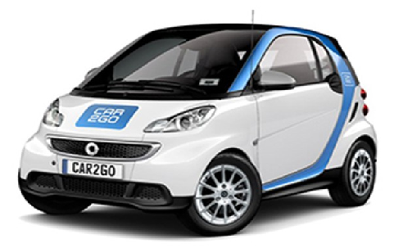

LIDAR (Light Detection and Ranging)_
Uses a lower power pulsating laser and a sensor. Differences in time and wavelength are
used to calculate distances in a 3D topology. Autonomous vehicles use LIDAR for obstacle detection and avoidance to navigate safely through environments, using rotating laser beams.
Measures distance for the time it takes the pulse to bounce back and the angle, where the pulse is moving at the speed of light.
Multiple time sequenced pulses are used to determine velocity and trajectory of object.

Slide 8
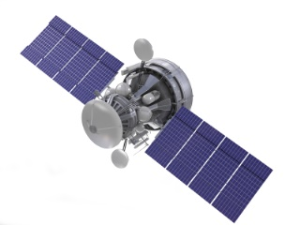
GPS (Global Positioning System)
A network of orbiting satellites that send precise details of their position in space back to earth. The signals are obtained by GPS receivers and are used to calculate the exact position, speed and time at the vehicles location.
GPS is a global navigation satellite system that uses at least 24 satellites, a receiver and algorithms to provide location, velocity and time synchronization for air, sea and land travel. The satellite system consists of six earth-centered orbital planes, each with four satellites.
A GPS receiver listens for the signals from the satellites. When it can get a lock on three or more satellite signals, it calculates how far away each satellite is from the known orbits of each satellite and the distance to each satellite, the receiver can triangulate its position.

Slide 9
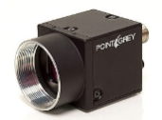
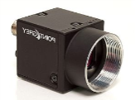
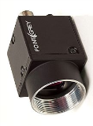
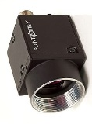



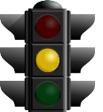
Camera (Object Detection)
Cameras are used to detect and classify objects 360 degrees around vehicle.
4-way or 360 view
Frames from continuous
video stream from cameras are ran through
trained convolutional
neural network to recognize objects.
Convolutional Neural Network
Detected Objects
Continuous Images

Slide 10
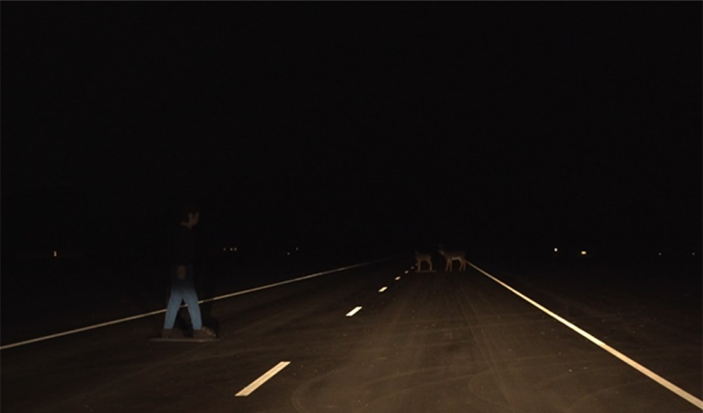
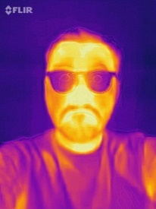

FLIR (Forward Looking Infrared Camera)
Camera uses infrared to detect heat signatures at night. Used for night vision.
Night-Time Conditions
CMOS Sensor
or Thermal Sensor
CMOS sensor provides low-cost low resolution, while more expensive thermal sensor provides significant more detail.
Convolutional Neural Network
Segmented Image
Detected Objects

Slide 11
IMU (Inertial Measurement Unit)
Determine motion and direction without external navigation system.
Navigation Signal is lost.
Maintains small changes in location and
direction from last navigation signal.
1 meter signal
Fine-tune (calibrate) path in learned location (driveway, parking lot, etc)
Local Coordinate System
The gyroscopes and accelerators measure motion on X,Y, Z axis and calculate change in direction and speed in local coordinate system.

Slide 12
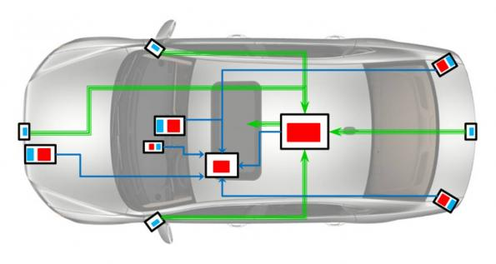
Radar
Used to detect short range distances (e.g., rear parking) where LIDAR is not effective.
Radar sensors typically placed in rear
for parking.
Radar sensors are very effective in measuring tiny changes in distance in real-time.

Slide 13
SLAM
Simultaneous Localization and Mapping (SLAM) is used
in the autonomous world for constructing and updating
a map of the local environment while operating in it.
Used in:
Aerial Drones
Autonomous Vehicles
Domestic Vehicles
Spacecraft
Common Algorithms:
Particle Filter (sequential Monte Carlo)
Kalman Filter

Slide 14
SLAM
Wikipedia: Given a series of sensor observations over discrete time steps, the SLAM problem is to compute an estimate of the agent's location and a map of the environment. All quantities are usually a probability.
P( m_{t},x_{t} | o_{1:t})
m_{t} -> Map of environment at time t
x_{t} -> Location at time t
o_{1:t} -> Series of observations through time t
Bayes Theorem (conditional probabilities)
What we want to predict.
What is known (true).
Statistical techniques used to approximate the above equation

Slide 15
Lower Chassis
Lower Chassis Interface and Sensor Coordination
Radar and Sonic
Sensor data fused
for real-time
Corrections to drive
system.
Drive Instructions
Performance
Measurements
(e.g., battery, current,
traction)
Local Navigation Corrections
Lower Chassis
Drive
Train
SLAM
Drive Actions
Parking, pothole
detection.
Curb detection, vehicle spacing,
sudden object detection (e.g., dog).
Continuous correction of speed
and spacing.
Sensors work in conjunction in lower chassis that the vehicle can drive independently of the “brains” and external navigation in parking, driveways, pothole detection curb avoidance, patrolling in predetermined path.

Slide 16
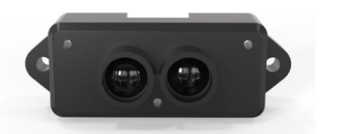


Upper Chassis
The Upper Chassis consists of the navigation and “brains”, which does Planning.
The “brains” operates in virtual world with no direct connections to sensors. Can be trained / debugged in simulator.
Terrain, Road, Structure
mapping
External Global Navigation (coord, altitude, speed)
Night vision
The “brains” builds models of the environment and vehicle by combining
what the sensors say with the performance
measurements.
Upper Chassis
Brains
Navigation
Location, Speed
4-way 360 camera views for
objection detection and classification.
Drive Instructions
Local Navigation Corrections
Data from GPS, LIDAR, cameras and lower chassis local corrections is fused together.
Performance
Measurements
(e.g., battery, current,
traction)

Slide 17
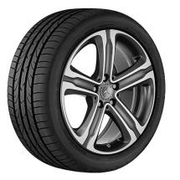
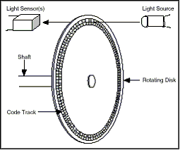
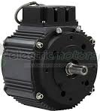
Electric Motor / Rotation Control
Optical Encoders used on wheels to guide precise small movements of the wheel.
Learned formula for
rotation vs.
condition.
Incline, road condition
Rotation Control
SLAM
Motor receives small rotation.
May under/overshoot – the optical encoder responds back while the actual rotation vs.
expected rotation.
Policy
Overshoot Corrections
Drive (Step) Instructions
Electric
Motor
Wheel
Optical Encoder
Data from Optical Encoder and SLAM is fused together to (reinforcement) learn current signals for precise rotations under road conditions.

Slide 18
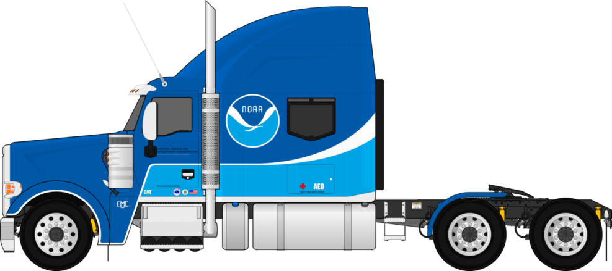
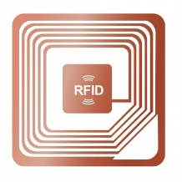


Tractor / Trailer
Automation of Weight Monitoring and Load Movement
Force Measurement from to pull load
Weight Monitoring
Policy
Trailer RFID tag: size, tare weight, identification
Transmit data to weigh stations.
Weigh stations verify weight. Can track changes in load weight to track loading and unloading (i.e., cargo changes), hours traveled, etc.

Slide 19
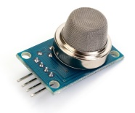


Bus / Transit Car
People counting in bus and transit cars done with multiple types of sensors
Camera uses anonymous facial recognition
to count people.
CO2 sensors measures CO2 emitted by people
Double Infrared beam
Track in/out
Each sensor has weaknesses. By fusing them together, the system can learn to accurately count people across varied situations.

